Slide 1
Student Management System
Nilesh Chavan Mangesh Chavan sangamesh daregave

Slide 2
Objective
The objective of this project is to develop a console-based Student Management System using Java as the programming language and MySQL as the database. The primary goal is to implement a simple, interactive application that demonstrates the integration of Java with a relational database through JDBC (Java Database Connectivity).
This system enables users to perform essential CRUD operations—Create, Read, Update, and Delete—on a students table in the database. The application allows the user to:
Add new student records with details such as student ID, name, age, email, department, and city.
View all existing records in a structured format.
Update specific fields of a student record, such as updating the email or department.
Delete student entries based on the student ID.
Search or Fetch individual student records using filters like ID or name.

Slide 3
Technologies Used
- Java 17
- MySQL 8+
- JDBC API
- IntelliJ IDEA
- MySQL Connector/J (mysql-connector-j-9.3.0.jar)

Slide 4
Functionality
1. Add Student(s)
2. View All Students
3. Update Student Age
4. Delete Student by ID
5. View Student by ID
0. Exit the program

Slide 5
📈 Scope for Enhancement
Add login/authentication for security.
Convert to a GUI app using JavaFX or Swing.
Export data to Excel/CSV.
Create REST APIs and make it a web service.
Input validations (email format, age range, etc.).

Slide 6
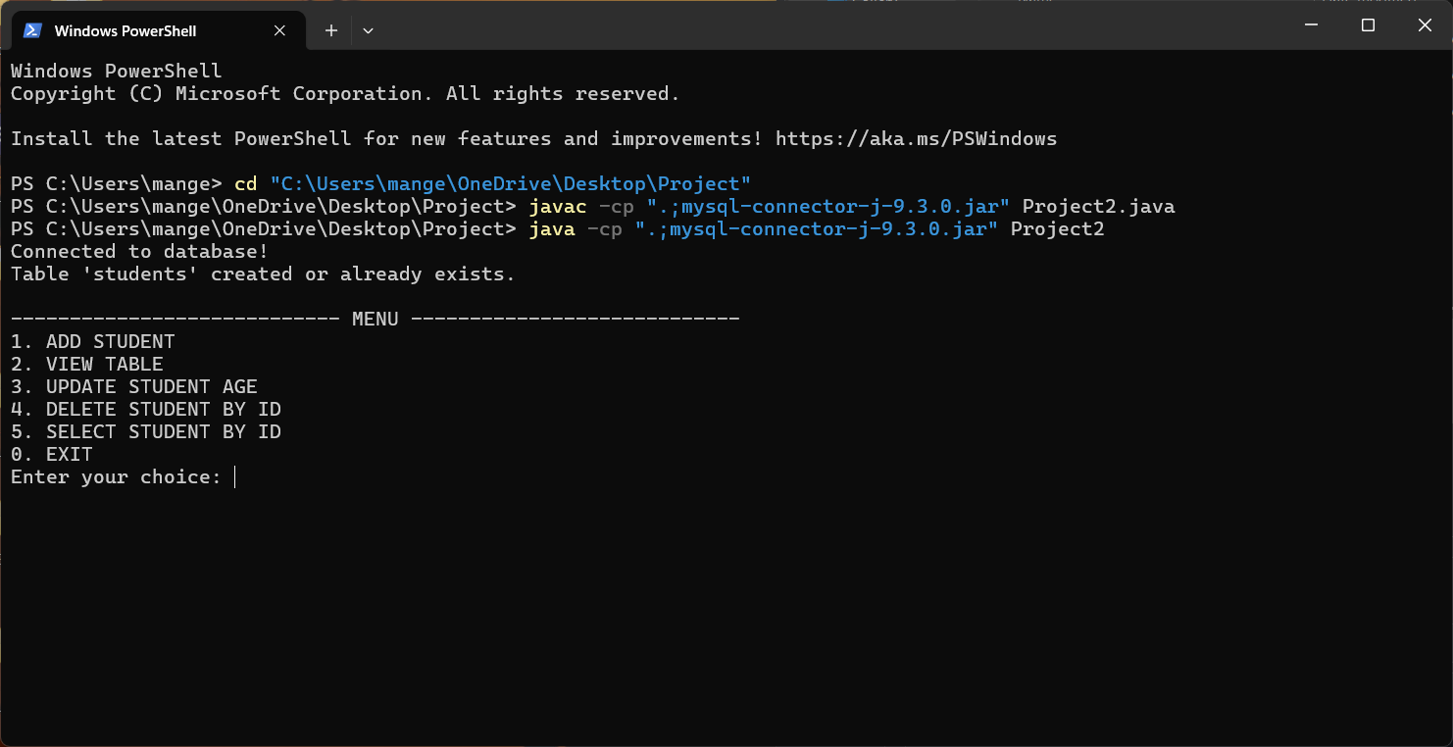
Sample Output Below is a sample menu and console output during program execution

Slide 7
Conclusion
The Student Management System project demonstrates how Java can be integrated with MySQL using JDBC to build a simple and functional console-based application. It performs essential CRUD operations on student data, providing hands-on experience with database connectivity, modular design, and exception handling.
This project meets its goal of efficiently managing student records and serves as a solid foundation for more advanced applications, such as GUI or web-based systems. It also reinforces core Java and SQL skills while opening up possibilities for future enhancements.

